Slide 1

Artificial Intelligence-2 (CSL 7040)
Lecture : Game Theory

Slide 2
Game Theory
Multi-agent decision making
Agents are acting optimally → Agent must play → Collective good → All the agents reach to the game theoretic solution → The solution that maximizes the agent’s own utility
Agent Design:
Mechanism Design:

Slide 3
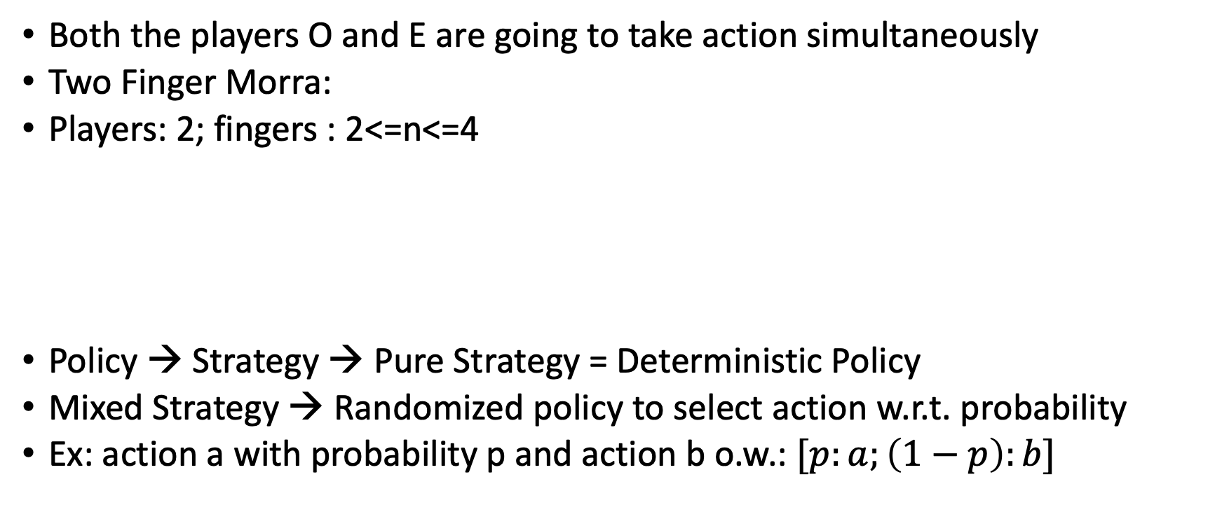
Single Move Game
Both the players O and E are going to take action simultaneously
Two Finger Morra:
Players: 2; fingers : 2<=n<=4
Policy → Strategy → Pure Strategy = Deterministic Policy
Mixed Strategy → Randomized policy to select action w.r.t. probability
Ex: action a with probability p and action b o.w.: $[p:a;\left(1−p\right):b]$
 | O: One | O: Two
E: One | E= +2, O=-2 | E=-3, O=+3
E: Two | E=-3, O=+3 | E=+4, O=-4

Slide 4
Prisoner’s Dieleman
Alice and Bob
Strongly dominant strategy: For a player p the strategy s is strongly dominating if outcome of s is better than s’ irrespective of other player’s choice.
Weakly dominant strategy:
Pareto Optimal: If there is no outcome that all the plyers will prefer.
Dominant Strategy Equilibrium: If both the players have the same dominant strategy
Nash Equilibrium: Every game has at least one equilibrium
 | Alice: Testify | Alice: Refuse
Bob: Testify | A=-5, B=-5 | A=-10, B=0
Bob: Refuse | A=0, B=-10 | A=-1, B=-1

Slide 5
Game Without Dominant Strategy
Games without any Nash Equilibrium or Pure Strategy
 | Acme: Blueray | Acme: DVD
Best: Blueray | A=+9, B=+9 | A=-4, B=-1
Best: DVD | A=-3, B=-1 | A=+5, B=+5

Slide 6
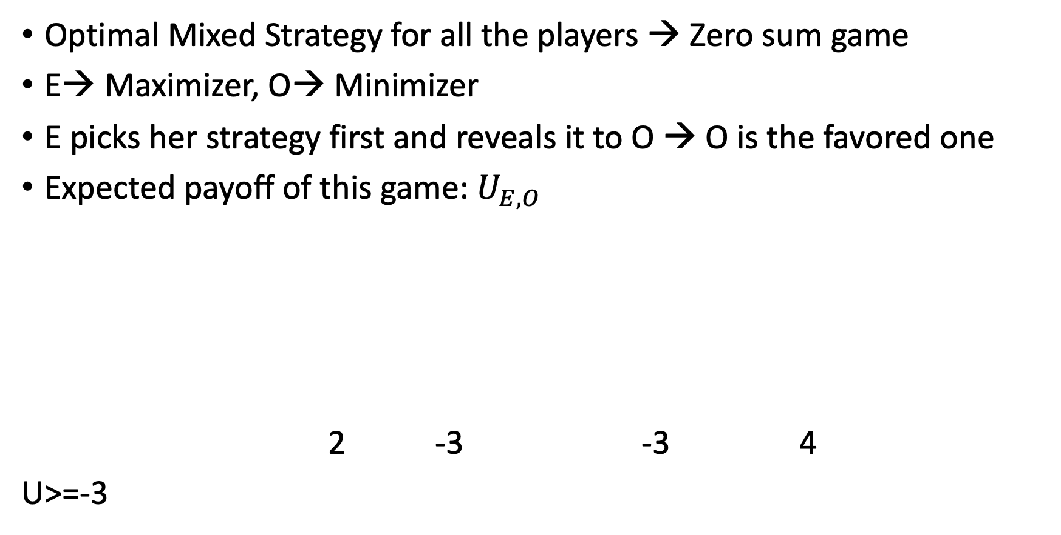
Coordination Game
Optimal Mixed Strategy for all the players → Zero sum game
E→ Maximizer, O→ Minimizer
E picks her strategy first and reveals it to O → O is the favored one
Expected payoff of this game: $U_{E, O}$
2 -3 -3 4
U>=-3
-3
E: Maximizer
One
Two
-3
-3
O: Minimizer
Two
One
Two
One
Two

Slide 7
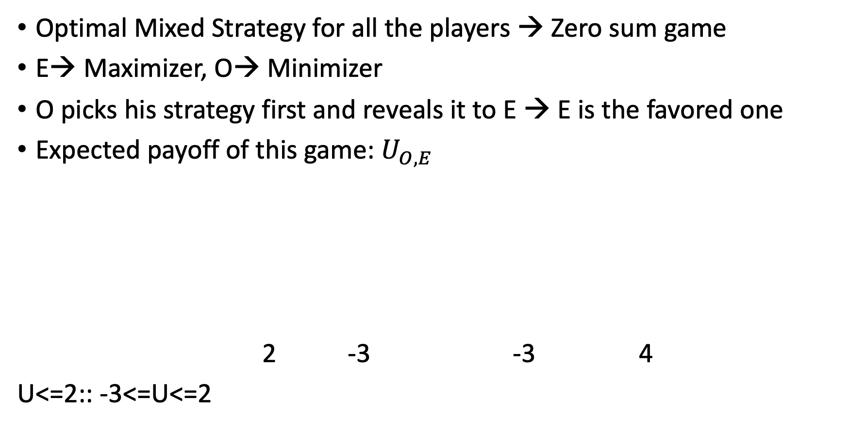
Coordination Game
Optimal Mixed Strategy for all the players → Zero sum game
E→ Maximizer, O→ Minimizer
O picks his strategy first and reveals it to E → E is the favored one
Expected payoff of this game: $U_{O, E}$
2 -3 -3 4
U<=2:: -3<=U<=2
2
O: Minimizer
One
Two
2
4
E: Maximizer
Two
One
Two
One

Slide 8
Coordination Game
i) first player revealing her strategy → second player may chose a pure strategy; if second player plays a mixed strategy: [p:one;(1-p):two]
E [p:one; (1-p):two]
5p-3=4-7p
p=7/12
U_{E,O}=-1/12
U_{O,E}=-1/12
One
Two
For mixed strategy for both the player:
Probability of chosing one=7/12
“ two=5/12
2p-3(1-p)
-3p+4(1-p)

Slide 9
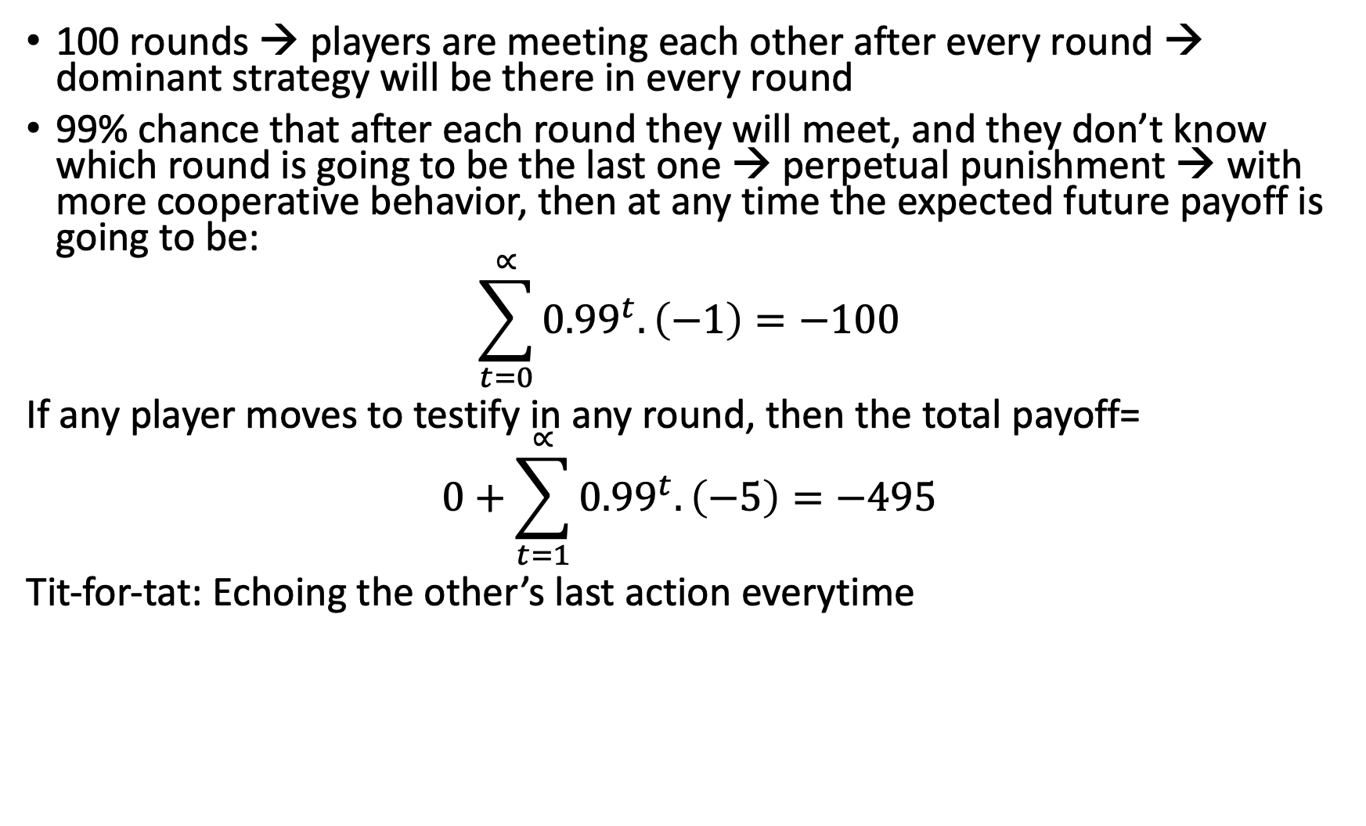
Repeated Games
100 rounds → players are meeting each other after every round → dominant strategy will be there in every round
99% chance that after each round they will meet, and they don’t know which round is going to be the last one → perpetual punishment → with more cooperative behavior, then at any time the expected future payoff is going to be:
$$\sum_{t=0}^{∝}{{0.99}^{t}.\left(−1\right)=−100}$$
If any player moves to testify in any round, then the total payoff=
$$0+\sum_{t=1}^{∝}{{0.99}^{t}.\left(−5\right)=−495}$$
Tit-for-tat: Echoing the other’s last action everytime

Slide 10
Sequential Gaming
Games with sequential terms → Represented by Game Tree
Tree Includes
Initial States (S₀)
Func (S)
Action(S) → possible functions
Results(s,a)→ Transfer to a new state
U(s,p)→ could be defined only on the terminal states
Insertion of ‘chance’ → Player’s action + chance

Slide 11
Sequential Gaming
Represent the partial observability → Creating game trees over belief states → enables some strategy ensures checkmate irrespective of the opponent’s move → Information set
Poker game → 4 cards → 2 kings and 2 aces --> 2 players
Player 1 → raise or fold
Player 2 → call or fold
P1: rk: raise if in I_{1,1} and check if in I_{1,2}
P2: cf: call if in I_{2,1} and fold if in I_{2,2}

Slide 12
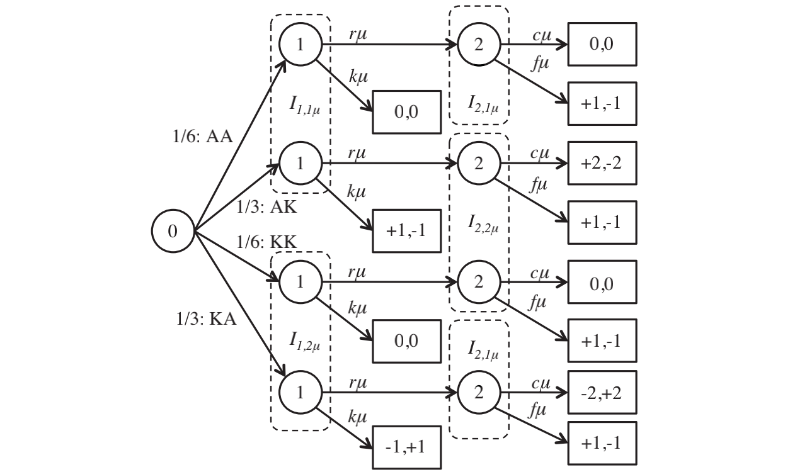
Sequential Gaming

Slide 13
Issues with GT
Games are imperfect, i.e.,
Harder to prune → mixed strategy are needed instead of pure strategy
Harder to heuristically determine the non-terminated nodes
Limitations of GT:
Doesn’t deal well with continuous state and action
It assumes the game is known, some part may be un-observable, but the player knows which part it is

